Slide 1
BITCOIN PRICE PREDICTION
ANAGHA C KANDATHIKUDIYIL
MCA-S4 A
Roll No:15

Slide 2
RELEVANCE OF TOPIC
Bitcoin is a crypto currency which is used worldwide for digital payment or simply for investment purposes.
The Bitcoin’s value varies just like a stock albeit differently.
Therefore it is necessary to predict the value of Bitcoin so that correct investment decisions can be made.
The price of Bitcoin does not depend on the business events or government unlike stock market.
Thus, it is necessary to leverage machine learning technology to predict the price of Bitcoin.

Slide 3
DESCRIPTION OF THE PROJECT
Bitcoin is the most complex cryptocurrency which changes its value in every second.
So it is important to predict the price of it for making any investment.
This project focuses on the accurate prediction of Bitcoin price using AutoTs.
The AutoTs library in Python is one of the best libraries for time series analysis.
Based on the predicted price rate we can decide either to sell, buy or to hold the stock.

Slide 4
OBJECTIVES OF THE STUDY
To ascertain with what accuracy can the price of Bitcoin be predicted using different machine learning algorithm and compare their accuracy.
To understand and identify daily trends in the Bitcoin market while gaining insight into optimal features surrounding Bitcoin price.
To ensure less risk and more profit for the investors.

Slide 5
EXISTING SYSTEM & PROPOSED SYSTEM
EXISTING SYSTEM
Existing work, predict trend of the stock. The trend can be considered as a pattern. They perform both short term predictions (day or week predictions) and also long-term predictions (months). They found that the latter produced better results with 79% accuracy.
Drawbacks
Instead of directly forecasting the future price of the stock, it analyzed trend only.

Slide 6
EXISTING SYSTEM & PROPOSED SYSTEM
PROPOSED SYSTEM
Acquire time-series data recorded daily for five certain time period at different time instances, it must be normalized and smoothened.
The next step is to select parameters that will be fed to the predictive network.
After feature selection, the sample inputs will be fed to the model.
The accuracy can be compared with different models after the final prediction.
Advantages
Implement more than one machine learning to predict the value
Accuracy are compared to show best algorithm for prediction

Slide 7
MODULES IDENTIFIED
PRICE PREDICTION
Price prediction on the considered dataset is done using two different machine learning algorithms such as Decision Tree and Linear regression.
The predicted value is compared for the predicted accuracy and error values.

Slide 8
MODULES IDENTIFIED
PRICE FORECAST
Price forecast is done for 10 days using machine learning techniques such as Decision tree and regression.
The result is compared with the score value to identify the accuracy value and plotted.
The forecast_set is an array of forecasts, showing that not only could you just seek out a single
prediction, but you can seek out many at once.

Slide 9
METHODOLOGY
The execution is carried out with following steps
Dataset collection from quandl.com
Dataset pre-processing
Split dataset as train and test set
Apply Machine learning Decision tree and linear regression
Train the model
Give test set and predict values
Price forecast for ten days

Slide 10
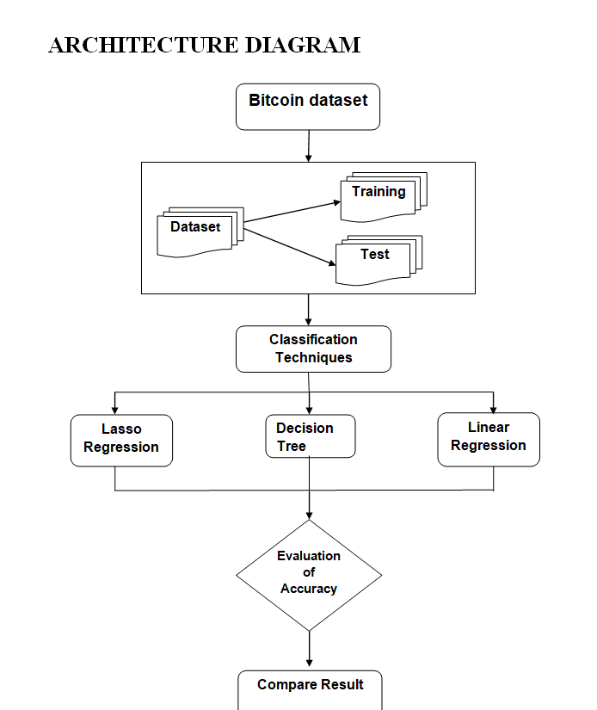
METHODOLOGY

Slide 11
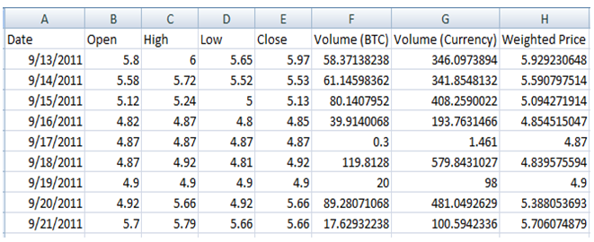
DATASET
As Bitcoin is a kind of stock traded in stock market, dataset will be available in plenty with all time intervals. Live data from 2011 to till date is collected from Quandl.com, which provided us the most comprehensive bitcoin price in datewise data.

Slide 12
DATASET
The dataset variable names are described below
Variable name | Short description
Date | Trading Date
Open | Bitcoin Open price for particular time
High | Bitcoin High price achieved for particular time
Low | Bitcoin Low price achieved for particular time
Close | Bitcoin Close price for particular time
Volume (BTC) | Coin volume traded
Volume (Currency) | Coin value traded
Weighted price | Price per coin traded

Slide 13


